Slide 1


Beamforming for V2V Communications Utilizing Deep Learning
EXTERNAL REVIEW
DEPARTMENT OF ELECTRONICS ENGINEERING
Team members: Guided By:
Mrs. P. Kasthuri
Aravindan SM (2020504515) Teaching Fellow
Ramana Srivats S (2020504568) Dept of Electronics
Shri Harish S (2020504583) Madras Institute of Technology,
Anna University

Slide 2
INTRODUCTION
V2V communication is expected to play a critical role for future transportation systems, making them more efficient.
In the context of 6G networks, significant investments in research, standardization, and infrastructure development are expected to prioritize the development and deployment of V2V technologies.
Beamforming techniques are considered essential to compensate for severe path loss in high-frequency communication, ensuring efficient V2V communication links with low latency.

Slide 3
OBJECTIVE
To develop a machine learning-based model, utilizing deep learning techniques
To predict optimal beams having sufficient mmWave received powers using vehicular position information.

Slide 4
LITERATURE SURVEY
S.NO | AUTHOR | TITLE | JOURNAL / CONFERENCE / PUBLISHER / YEAR | SIGNIFICANT CONTRIBUTION
1 | Muhammad Baqer Mollah Honggang Wang Hua Fang | Position Aware 60 GHz mmWave Beamforming for V2V Communications Utilizing Deep Learning | IEEE International Conference on Communications (ICC), Denver, CO, USA YEAR:2024 | Proposes vehicular position data for beam prediction, reducing mmWave V2V latency. Experimentally validates 60 GHz mmWave V2V improvement.
2 | Muhammad Alrabeiah Ahmed Alkhateeb | DeepSense 6G: A Large-Scale Real-World Multi-Modal Sensing and Communication Dataset | IEEE Communications Magazine YEAR:2019 | Introduces the DeepSense 6G dataset, comprising real-world multi-modal sensing and communication data.

Slide 5
LITERATURE SURVEY (Cntd.)
S.NO | AUTHOR | TITLE | JOURNAL / CONFERENCE / PUBLISHER / YEAR | SIGNIFICANT CONTRIBUTION
3 | Muhammad Alrabeiah Andrew Hredzak Ahmed Alkhateeb | Millimeter Wave Base Stations with Cameras: Vision Aided Beam and Blockage Prediction | IEEE Vehicular Technology Conference YEAR:2019 | Investigates vision for mmWave communication challenges in 5G+. Suggests using base station cameras for beam selection and prediction, yielding high accuracy with minimal overhead.
4 | Hao Luo Umut Demirhan Ahmed Alkhateeb | Millimeter Wave V2V Beam Tracking using Radar: Algorithms and Real-World Demonstration | 31st European Signal Processing Conference (EUSIPCO) YEAR:2023 | Investigates radar sensing for dynamic V2V communication. Develops a beam-tracking framework combining radar and machine learning, showing potential for V2V beam management.

Slide 6
LITERATURE SUMMARY
V2V communication will play a vital role in the future of autonomous vehicles and a proper beam forming technique is significant.
However, performing accurate beam alignment over such narrow beams for efficient link configuration by traditional beam selection approaches, mainly relied on channel state information, typically impose significant latency and computing overheads, which is often infeasible in vehicle-to-vehicle (V2V) communications .
From the above literature survey we come up with a solution to efficiently predict beams for an efficient V2V communication link.

Slide 7
EXISTING METHODOLOGY
Vehicles conduct exhaustive measurements to identify optimal beam pairs.
This involves testing various beam configurations to determine the best-performing combination.
Begin by establishing a set of candidate beam pairs based on predefined codebooks.
Measure the quality of each beam pair by assessing factors such as signal strength and interference levels.
Select the beam pair that offers the highest quality communication link for transmission.

Slide 8
DEEP SENSE 6G DATASET
The DeepSense 6G dataset consists of real-world multi-modal dataset collected from multiple locations in Arizona, USA. The primary aim of this dataset is to enable a wide range of applications in communications, sensing, and localization.
The DeepSense 6G dataset is (i) a large-scale dataset of more than 1 million data points, (ii) based on real-world measurements.
The dataset consists of diverse deployment scenarios, covering over 40 instances. It includes synchronized multi-modal sensing and communication data, spanning vehicle-to-infrastructure, vehicle-to-vehicle, pedestrian, drone communication, fixed-wireless, and indoor use cases.

Slide 9
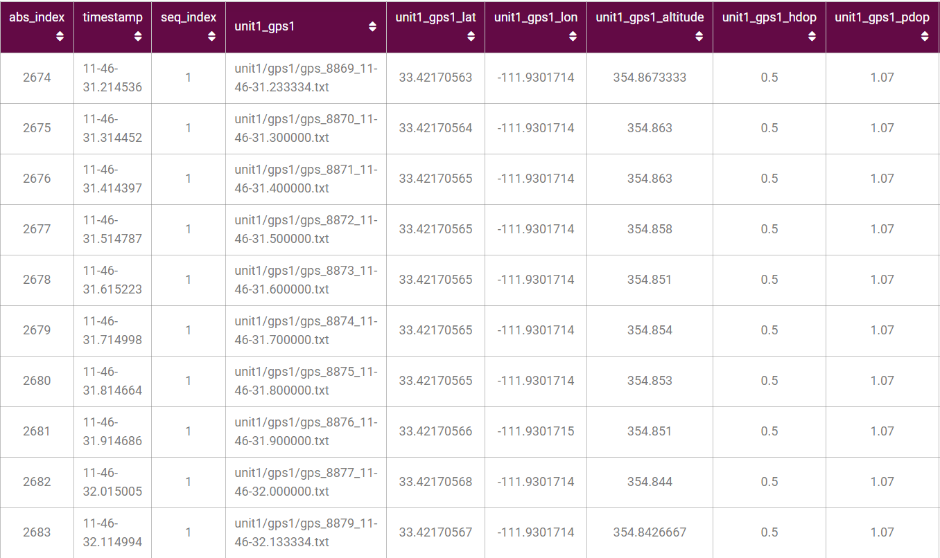
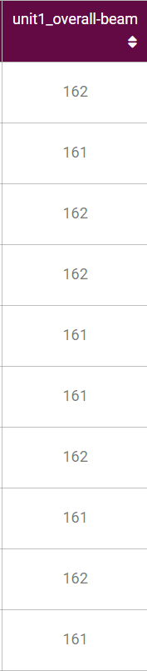
GPS SAMPLE DATASET
Fig.1. DeepSense 6G dataset

Slide 10
BASE SOLUTION
Utilize input positions for car1 and car2 to predict their positions at the new timestamp through linear extrapolation.
Calculate the angle of arrival using the estimated positions.
Determine the optimal beam based on the estimated angle of arrival, assuming uniform distribution in the angular domain.
Evaluate the top-k accuracy to measure the performance of the estimation process.

Slide 11
RESULTS OF BASE SOLUTION
Top k-beam accuracy
﻿﻿Scenario | APL | Top1 | Top3 | Top5
36 | -4.81 dB | 31.18 | 62.6 | 70.41
37 | -4.10 dB | 24.05 | 58.6 | 70.47
38 | -8.12 dB | 10.69 | 32.2 | 45.57
39 | -8.02 dB | 22.45 | 49.18 | 60.34

Slide 12
DATASET MODIFICATION
The dataset has been modified such that new parameters such as angle of arrival, velocity and distance between cars have been added.
Since the latitude and longitude values are very specific we consider relative positions.
Using haversine formula the distance between the cars is calculated using the latitude and longitude.
From the calculated distance we determine the velocity by subtracting the future the 5th sample from the future position divided by 500ms.
Calculated the aoa(angle of arrival) of previous time sample.
Calculated the rate of change of aoa between the two cars.

Slide 13
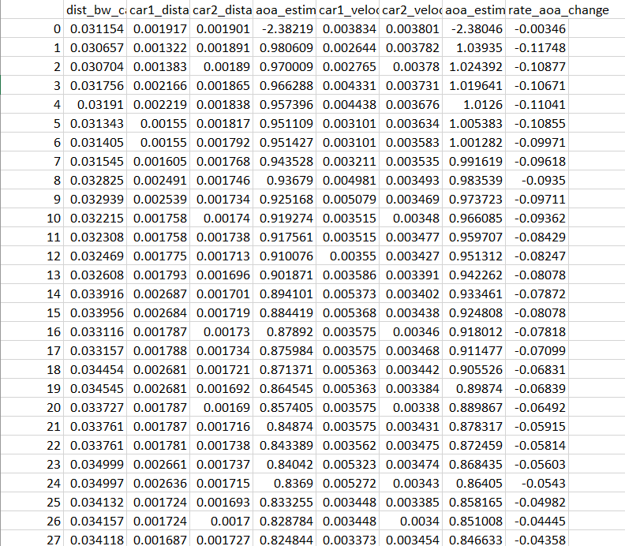
MODIFIED DATASET SAMPLE
Fig.2. Modified DeepSense 6G dataset

Slide 14
SCENARIOS
Scenarios 36 and 38 are collected in an outdoor wireless environment and are explicitly designed to study high-frequency V2V communication in the real world.
The dataset is collected using DeepSense testbed. The testbed comprises two units: Unit 1, a mobile receiver (vehicle) equipped with advanced sensing capabilities, and Unit 2, a mobile transmitter.
Scenarios 36 and 37 are collected in long drives between cities, targeting long travels, and are referred to as inter-city scenarios.
Scenarios 38 and 39 are predominantly focused on emulating short urban commutes, capturing data primarily within city boundaries.
The distinction between these scenarios is supported by the variations in traveled distances and average speeds of the vehicles. Scenarios 36 involve traveling long distances at relatively high average speeds, while Scenarios 38 covers shorter distances at lower speeds due to speed limits imposed within cities.

Slide 15
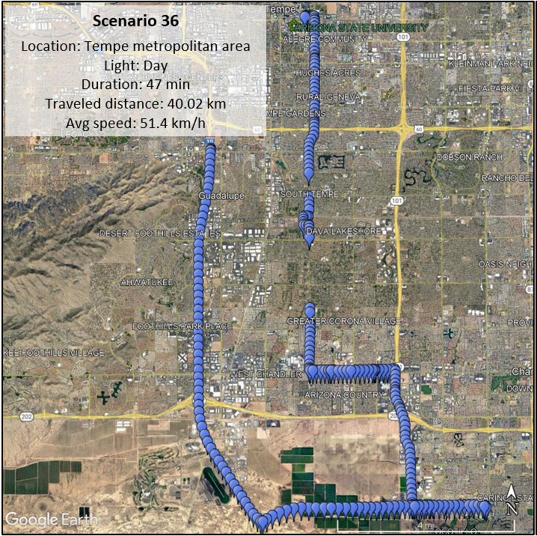
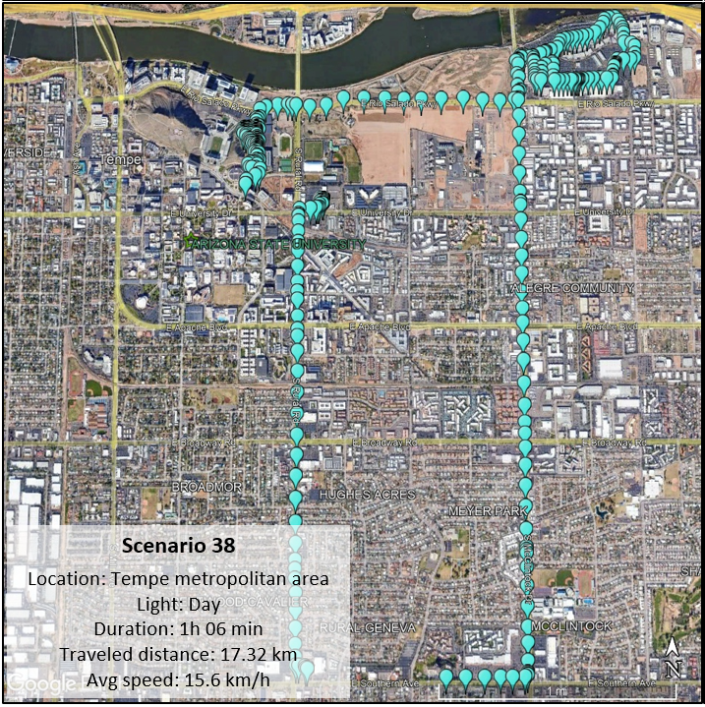
SCENARIOS 36 AND 38

Slide 16
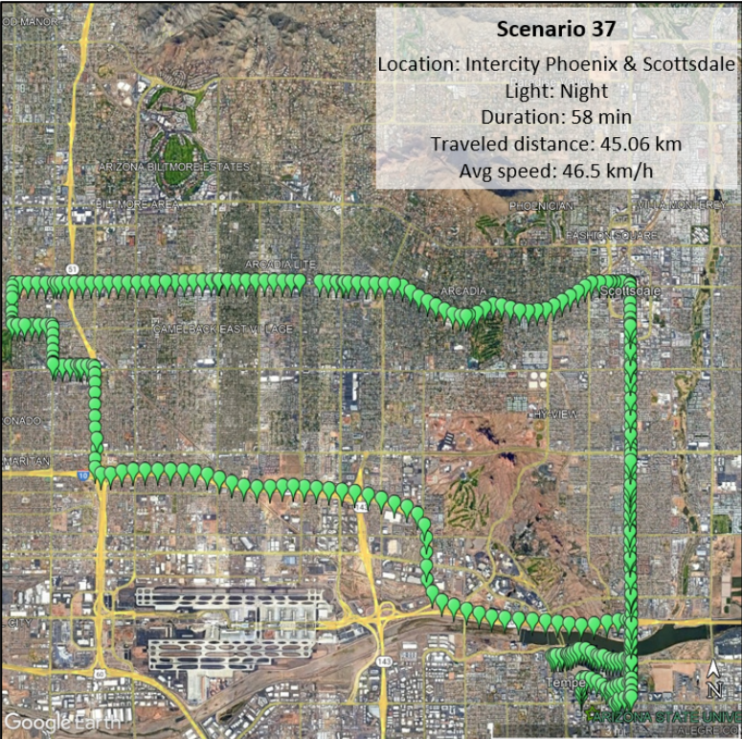
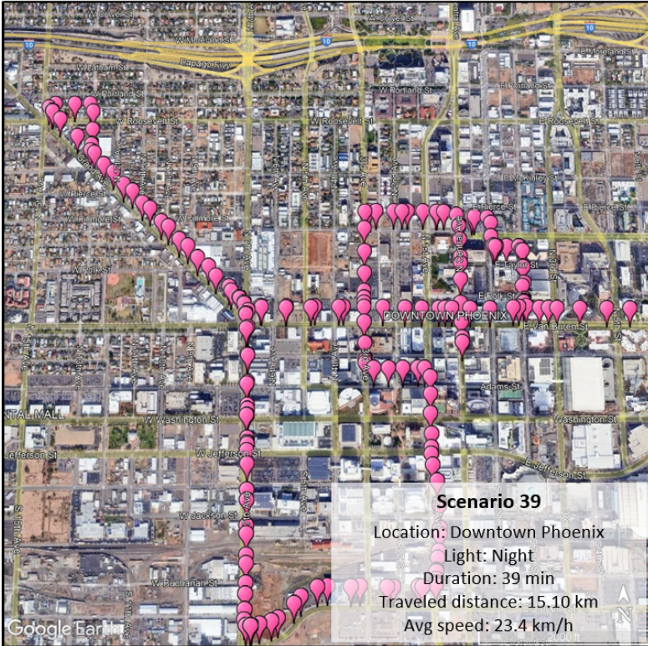
SCENARIOS 37 AND 39

Slide 17
ANN MODEL
This neural network model follows a sequential architecture, comprising 3 densely connected layers.
The input layer consists of 1024 units with Rectified Linear Unit (ReLU) activation function, accepting input data of shape (6).
Subsequent hidden layers include:
1.A layer with 768 units, activated by ReLU.
2.Another layer with 512 units, also activated by ReLU.
3.A final hidden layer with 256 units, utilizing ReLU activation.
The output layer consists of 256 units, employing the softmax activation function to output probabilities for each class.

Slide 18
SVM MODEL
A support vector machine (SVM) is defined as a machine learning algorithm that uses supervised learning models to solve complex classification, regression, and outlier detection problems by performing optimal data transformations that determine boundaries between data points based on predefined classes, labels, or outputs.
The goal of the SVM algorithm is to create the best line or decision boundary that can segregate n-dimensional space into classes so that we can easily put the new data point in the correct category in the future. This best decision boundary is called a hyperplane.
The hyperplane tries that the margin between the closest points of different classes should be as maximum as possible. The dimension of the hyperplane depends upon the number of features.

Slide 19
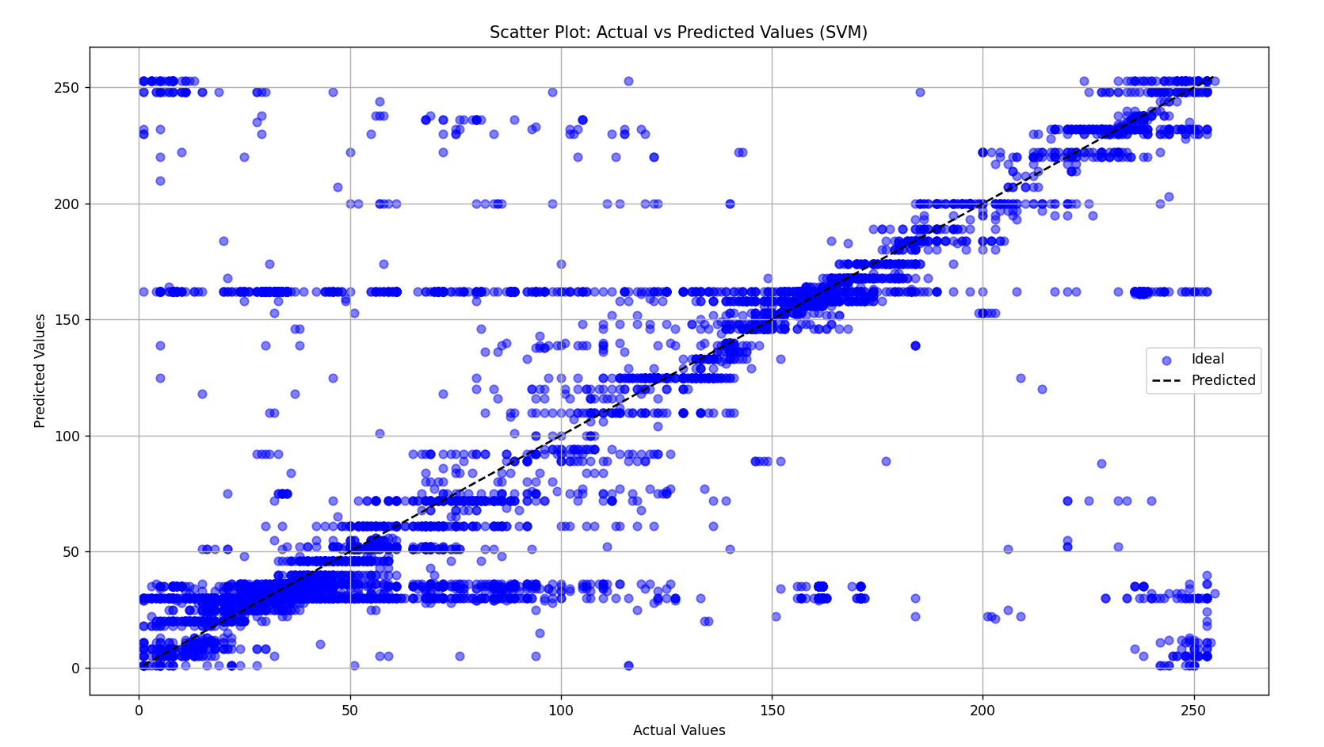
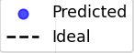
Scatter Plot of Actual and Predicted Beam Index for SVM Model
Fig.3. Scatter plot of SVM model

Slide 20
KNN MODEL
The k-nearest neighbors (KNN) algorithm is a non-parametric, supervised learning classifier, which uses proximity to make classifications or predictions about the grouping of an individual data point.
It operates based on the principle that similar data points tend to belong to the same class or have similar output values. For a given data point, KNN identifies its K nearest neighbors in the feature space and assigns a class label or predicts a value based on the most common class label or average value among its neighbors.
The K-NN algorithm works by finding the K nearest neighbors to a given data point based on a distance metric, such as Euclidean distance. The class or value of the data point is then determined by the majority vote or average of the K neighbors.

Slide 21
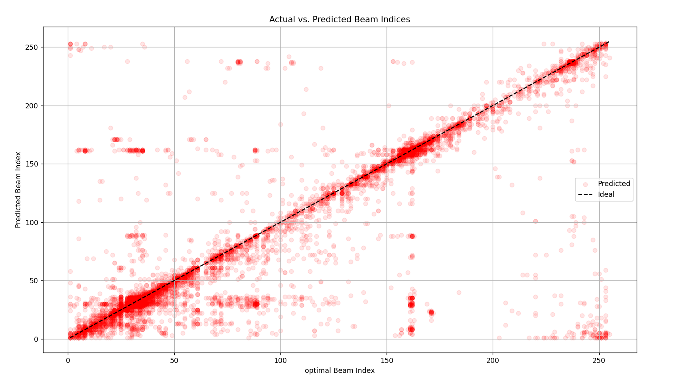
Scatter Plot of Actual and Predicted Beam Index for KNN Model
Fig.4. Scatter plot of KNN model

Slide 22
RESULTS
Top k-beam accuracy for Scenario 36:
TOP K | TOP1 | TOP3 | TOP5
ANN | 36 | 58.87 | 66.88
K-NEAREST NEIGHBORS | 51.13 | 76.42 | 81.77
SUPPORT VECTOR MACHINE | 43.45 | 67.47 | 74.48

Slide 23
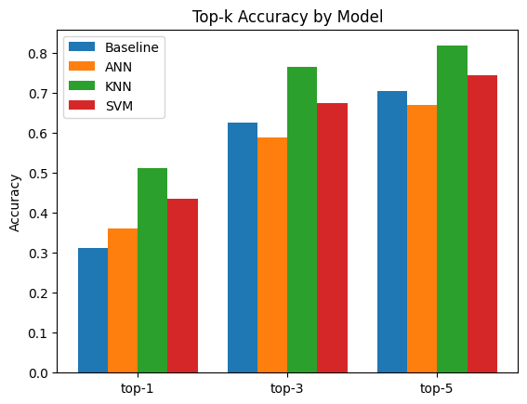
TOP-K ACCURACY COMPARISION
Top k-beam accuracy for Scenario 36
Fig.5. Top-K comparison for scenario 36

Slide 24
RESULTS
Top k-beam accuracy for Scenario 38:
TOP K | TOP1 | TOP3 | TOP5
K-NEAREST NEIGHBORS | 32.96 | 56.68 | 66.84
SUPPORT VECTOR MACHINE | 23.29 | 42.8 | 52.42
Top k-beam accuracy for Scenario 36 and 38:
MODEL | TOP1 | TOP3 | TOP5
K-NEAREST NEIGHBORS | 37.4 | 60.21 | 68.22
SUPPORT VECTOR MACHINE | 25.94 | 42.27 | 50.58

Slide 25
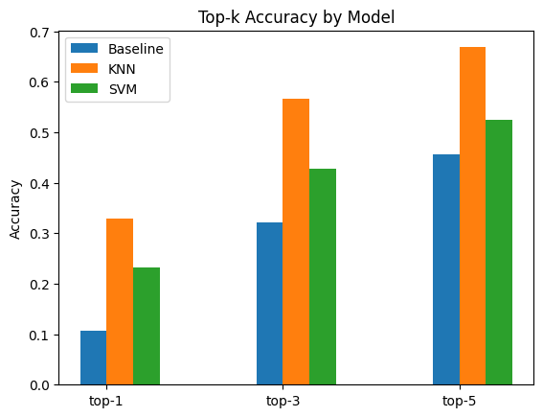
TOP-K ACCURACY COMPARISION
Top k-beam accuracy for Scenario 38
Fig.6. Top-K comparison for scenario 38

Slide 26
RESULTS
Top k-beam accuracy for Random forest:
Scenario | TOP1 | TOP3 | TOP5 | Avg. power loss
36 | 58.83 | 84.68 | 88.49 | -0.77
37 | 55.38 | 88.65 | 93.62 | -0.45
38 | 43.26 | 73.65 | 82.42 | -1.78
39 | 49.16 | 85.99 | 93.53 | -0.67
combined | 46.93 | 77.27 | 85.37 | -1.45

Slide 27
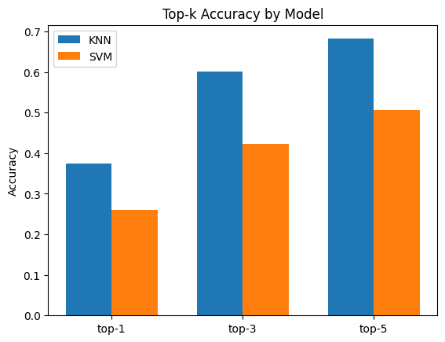
TOP-K ACCURACY COMPARISION
Top k-beam accuracy using both scenario 36 and 38.
Fig.7. Top-K comparison for scenario 36 and 38

Slide 28
RANDOM FOREST MODEL
Random Forest is a powerful ensemble learning technique that enhances predictive accuracy by aggregating the outputs of multiple decision trees.
It employs bootstrap sampling to create diverse subsets of the training data and introduces randomness by considering only a random subset of features at each split in each tree.
Through recursive construction, decision trees are built to maximize predictive performance, selecting the best features for splitting at each node.
The final prediction is then determined by averaging (for regression) or voting (for classification) across all individual trees. Random Forest is prized for its robustness against overfitting and its ability to handle missing data.

Slide 29
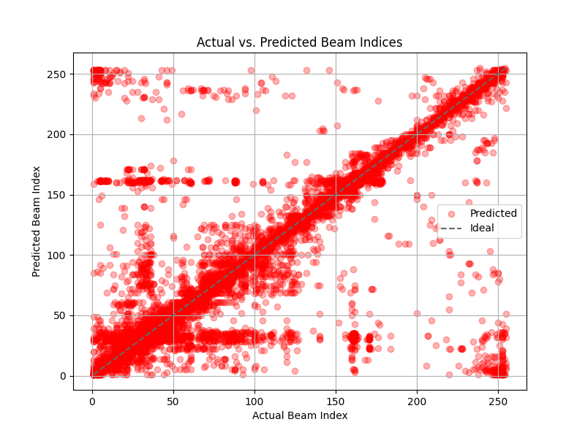
Scatter Plot of Actual and Predicted Beam Index for RF Model
Fig.8. Scatter plot of RF model

Slide 30
RESULTS
Top k-beam accuracy for Random forest:
Scenario | TOP1 | TOP3 | TOP5 | Avg. power loss
36 | 58.83 | 84.68 | 88.49 | -0.77
37 | 55.38 | 88.65 | 93.62 | -0.45
38 | 43.26 | 73.65 | 82.42 | -1.78
39 | 49.16 | 85.99 | 93.53 | -0.67
combined | 46.93 | 77.27 | 85.37 | -1.45

Slide 31
XGBOOST MODEL
XGBoost stands as a leading machine learning algorithm renowned for its exceptional performance in handling structured and tabular data across various predictive modeling tasks.
XGBoost employs a gradient boosting framework, where decision trees are sequentially constructed to iteratively correct the errors of previous trees. This approach ensures superior predictive accuracy while mitigating overfitting through the integration of regularization techniques such as L1 and L2 regularization.
With a plethora of tunable hyperparameters, XGBoost facilitates meticulous model optimization, empowering users to achieve optimal performance across a wide array of machine learning applications.

Slide 32
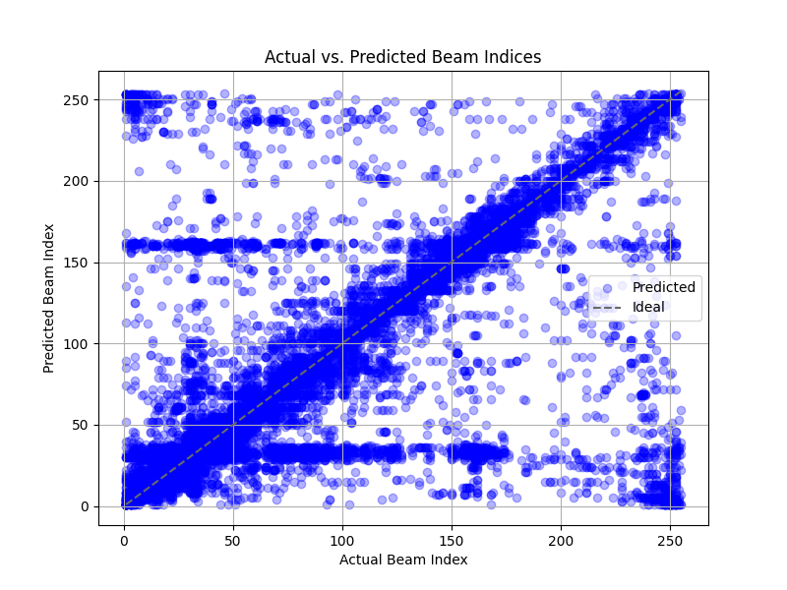
Scatter Plot of Actual and Predicted Beam Index for XGBOOST Model
Fig.9. Scatter plot of XGBoost model

Slide 33
RESULTS
Top k-beam accuracy for XGBoost:
Scenario | TOP1 | TOP3 | TOP5 | Avg. power loss
36 | 48.21 | 75.67 | 80.98 | -2.24
37 | 43.6 | 77.76 | 85.34 | -1.69
38 | 34.95 | 62.62 | 72.46 | -3.24
39 | 43.68 | 80.92 | 90.69 | -1.13
combined | 33.54 | 62.5 | 74.77 | -2.81

Slide 34
DECISION TREE MODEL
The decision tree model is a versatile and interpretable machine learning algorithm used for both classification and regression tasks.
It operates by recursively partitioning the dataset into subsets based on feature values, forming a tree-like structure where each internal node represents a feature and a split point, while each leaf node represents a predicted class label or value. Decision trees also provide valuable insight into feature importance, aiding in feature selection and interpretation.
Despite their simplicity, decision trees offer computational efficiency during both training and prediction, making them applicable to large datasets and real-time applications.

Slide 35
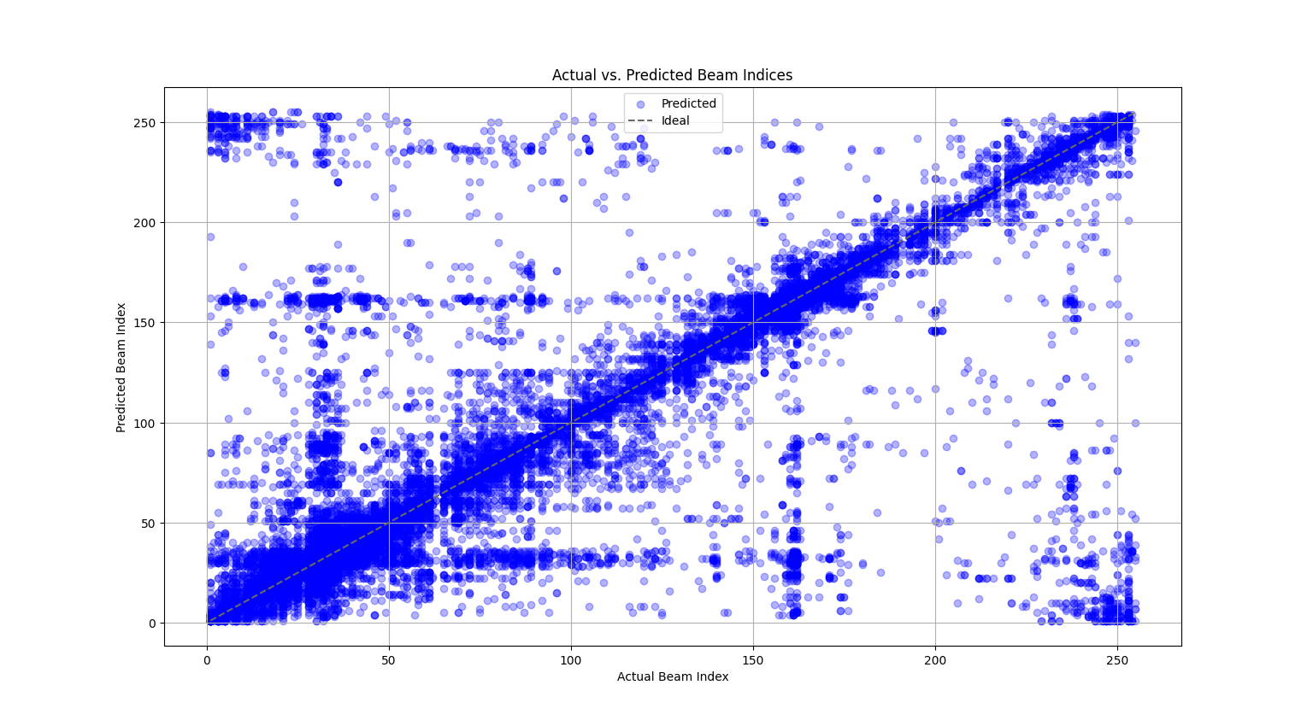
Scatter Plot of Actual and Predicted Beam Index for Decision Tree Model
Fig.10. Scatter plot of Decision Tree model

Slide 36
RESULTS
Top k-beam accuracy for Decision Tree:
Scenario | TOP1 | TOP3 | TOP5 | Avg. power loss
36 | 50.17 | 79.86 | 85.18 | -1.19
37 | 45.75 | 80.07 | 87.78 | -1.10
38 | 30.57 | 57.55 | 67.25 | -4.13
39 | 39.75 | 77.16 | 87.87 | -1.46
combined | 35.27 | 64.52 | 74.9 | -2.82

Slide 37
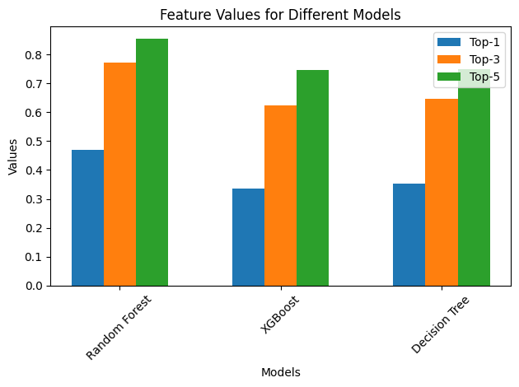
TOP-K ACCURACY COMPARISION
Top k-beam accuracy :
Fig.11. Top-k comparison for combined scenarios

Slide 38
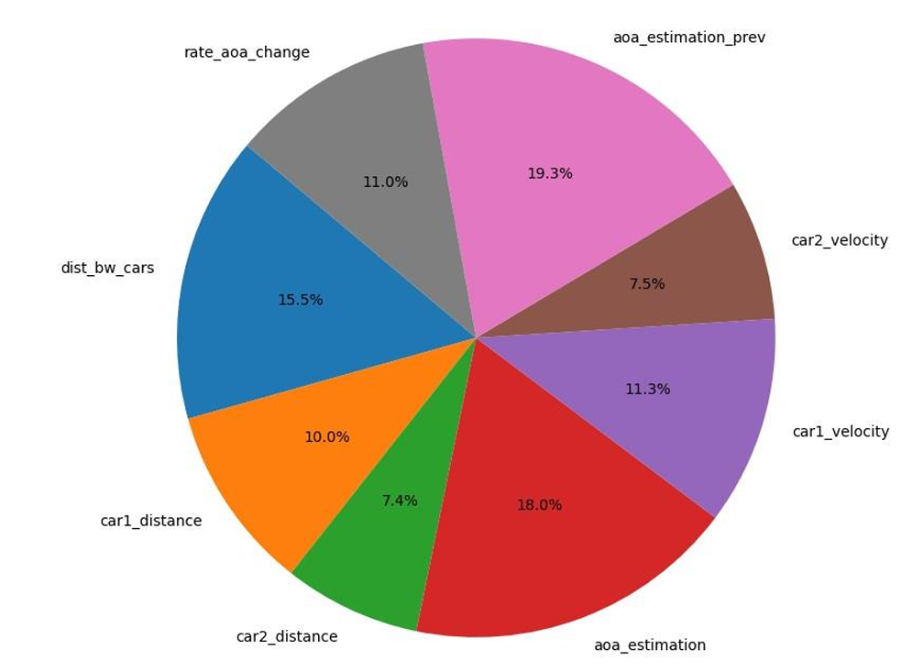
Feature Contribution
Fig.12. Feature contribution for accuracy

Slide 39
CONCLUSION
From the above results we infer that Random Forest model performs best and gives higher accuracy and is a ideal model for predicting the optimal beam for communication. Since the dataset is imbalanced we see that the tree algorithms perform better compared to other models. We can see that the ML model performs better in highway scenario compared to city scenario.
Our model will perform better with more data since at present the dataset is limited.
While Random Forest tends to yield higher accuracy, it comes at the cost of longer processing times. In contrast, XGBoost offers superior efficiency in terms of processing time, making it a preferable choice in time-sensitive scenarios.
Hence by using machine learning model ideally Random forest and XGBoost we efficiently predict optimal beams and reduce training overhead unlike traditional methods.

Slide 40
REFERENCES
1. Muhammad Baqer Mollah,Honggang Wang and Hua Fang, Position Aware 60 GHz mmWave Beamforming for V2V Communications Utilizing Deep Learning. In IEEE International Conference on Communications (ICC) 2024
2. Muhammad Alrabeiah and Ahmed Alkhateeb,Deep Learning for mmWave Beam and Blockage Prediction Using Sub-6GHz Channels. In arXiv:1910.02900v1 [cs.IT]2019
3. Muhammad Alrabeiah,Andrew Hredzak and Ahmed Alkhateeb, Millimeter Wave Base Stations with Cameras: Vision Aided Beam and Blockage Prediction. In arXiv:1911.06255v2 [cs.IT] 2019
4. Hao Luo,Umut Demirhan and Ahmed AlkhateebMillimeter Wave V2V Beam Tracking using Radar: Algorithms and Real-World Demonstration . In arXiv:2308.01558v2 [eess.SP] 2023
5. Hao Ye ,Geoffrey Ye Li and Biing-Hwang Fred Juang, Deep Reinforcement Learning Based Resource Allocation for V2V Communications. In IEEE transactions on vehicular technology Letters, 2019.
6. A. Alkhateeb, G. Charan, T. Osman, A. Hredzak, J. Morais, U. Demirhan, and N. Srinivas, “Deepsense 6G: A large-scale real-world multi-modal sensing and communication dataset,” IEEE Communications Magazine, pp. 1–7, 2023.

Slide 41
THANK YOU

